Slide 1
INSTALL MIDONET, LEARN IT, AND DEVELOP SAMPLE LABS
Suraj Raghavendra Vadvadgi

Slide 2
OBJECTIVE
Aim: To develop a lab program on midonet using openstack.
Achieved: Built a topology using public and private cloud environments for network virtualizations and executed some midonet commands.

Slide 3
TOOLS USED
Openstack Horizon Dashboard.
Midonet CLI.
Oracle VM Virtual Box.
Unix commands.

Slide 4
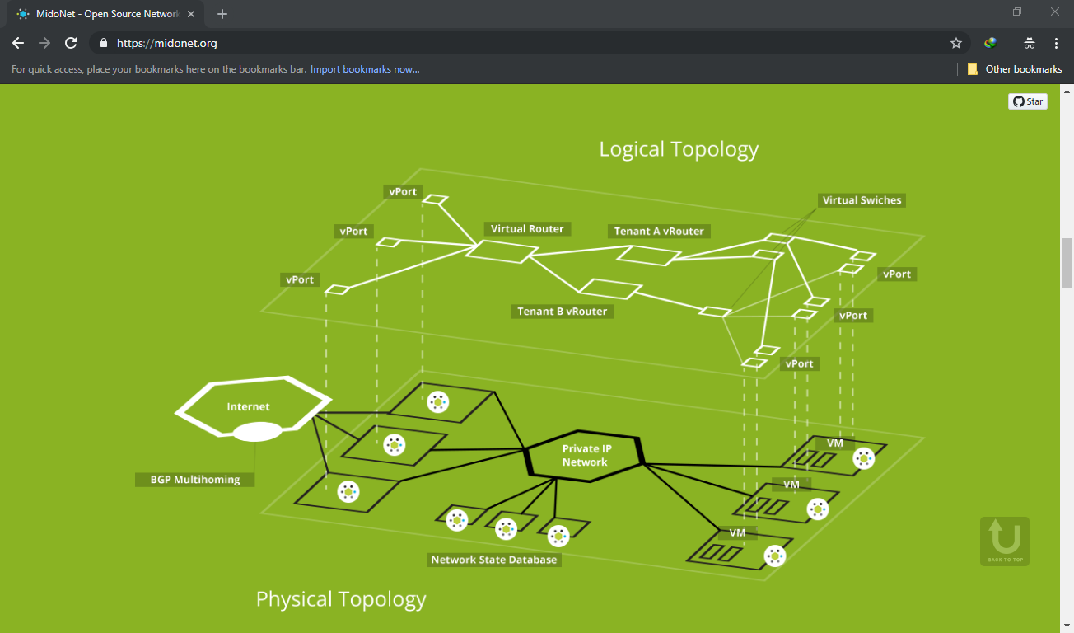
WHAT MIDONET IS AND DOES?
MidoNet is an advanced software defined networks technique which supports network virtualization for public and private cloud environments.
MidoNet is an Apache licensed production grade network virtualization software for Infrastructure-as-a-Service (IaaS) clouds.
MidoNet decouples your IaaS cloud from your network hardware, creating an intelligent software abstraction layer between your end hosts and your physical network. This network abstraction layer allows the cloud operator to move what has traditionally been hardware-based network appliances into a software-based multi-tenant virtual domain.

Slide 5
MIDONET ENABLES FEATURES
Reduced complexity of physical network
High availability (any server, any network service, any time)
Scalability through hierarchy
Reduced protocols
Optimized network traffic with minimal overhead
Vastly improved fault tolerance
Virtual L2 Distributed Switching
Virtual L2 Isolation
Virtual L3 Distributed Routing
Virtual L3 Isolation
L4 Services (Load Balancing, Firewall)
NAT / Floating IP's
Access Control Lists (ACLs) and Security Groups
Restful API
OpenStack integration

Slide 6
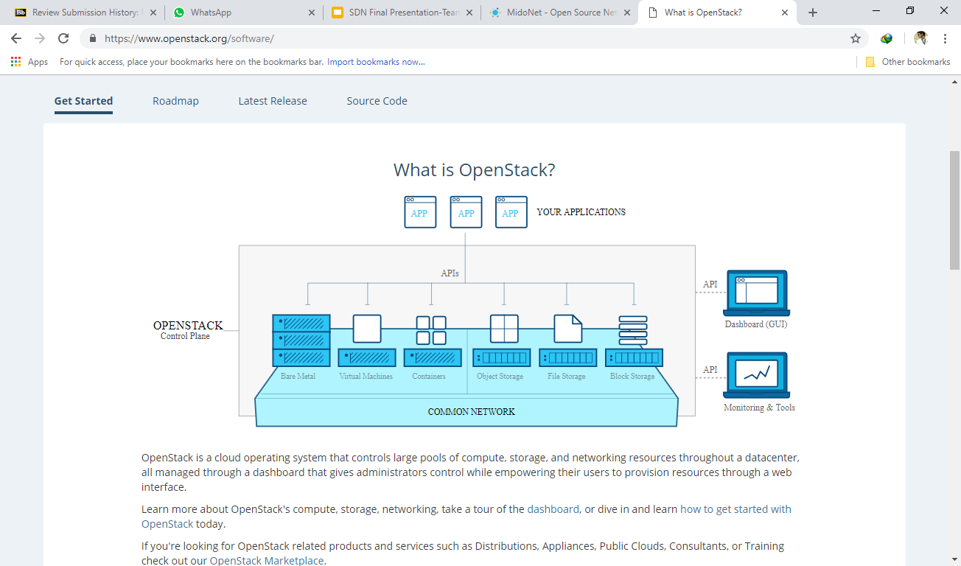
OPENSTACK
OpenStack is a cloud operating system that controls large pools of compute, storage, and networking resources throughout a datacenter, all managed through a dashboard that gives administrators control while empowering their users to provision resources through a web interface.

Slide 7
OPENSTACK SERVICES
Openstack Components | Openstack Services | Compute | NOVA, ZUN, QINLING
 |  | Bare Metal | IRONIC, CYBORG
 |  | Storage | SWIFT, CINDER, MANILA
 |  | Networking | NEUTRON, OCTAVIA, DESIGNATE
 |  | Shared Services | KEYSTONE, GLANCE, BARBICAN,KARBOR,SEARCHLIGHT
 |  | Orchestration | HEAT, SENLIN, MISTRAL, ZAQAR, BLAZAR, AODH
 |  | Application Life Cycle | MASAKARI, MURANO, SOLUM, FREEZER
 |  | API Proxies | EC2API
 |  | Web Frontend | HORIZON
 | Operation Services | Monitoring Tools | CEILOMETER, PANKO, MONASCA
 |  | Optimization/Policy tools | WATCHER, VITRAGE, CONGRESS, RALLY
 |  | Billing/Business Logic | CLOUDKITTY
 |  | Multi-Rgion Tools | TRICIRCLE
 | Add-Ons Services | Swift add-ons | STORLETS
 | Bridges for adjacent Tech | Containers | KURYR
 |  | NFV | TACKER
SDKs |  | Command-line Clients | OPENSTACKCLIENT, SHADE
 |  | Python SDKs | OPENSTACKSDK
Deployment Tools |  | Frameork for Life Cycle Management | TRIPLEO, OPENSATCK-HELM, KOLLA-ANSIBLE, OPENSTACK-ANSIBLE, OPENSTACK-CHARMS, BIFROST
 |  | Packaging Recipes for Popular Frameworks | LOCI, PUPPET-OPENSTACK, CHEF-OPENSTACK, RPM-PACKAGING

Slide 8
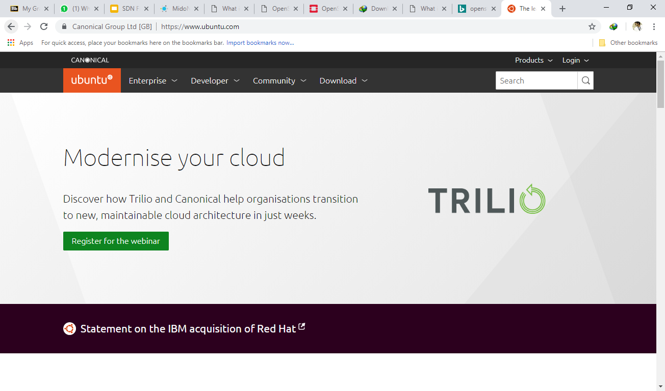
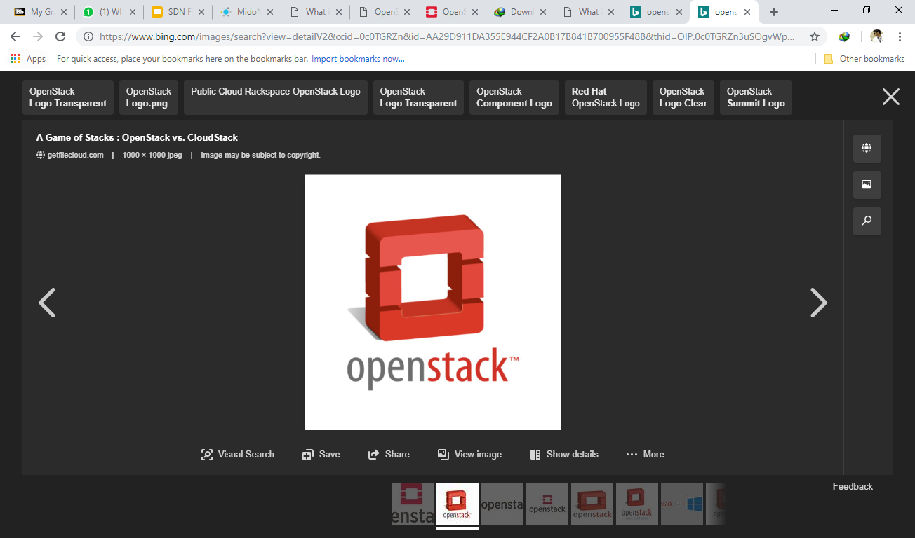
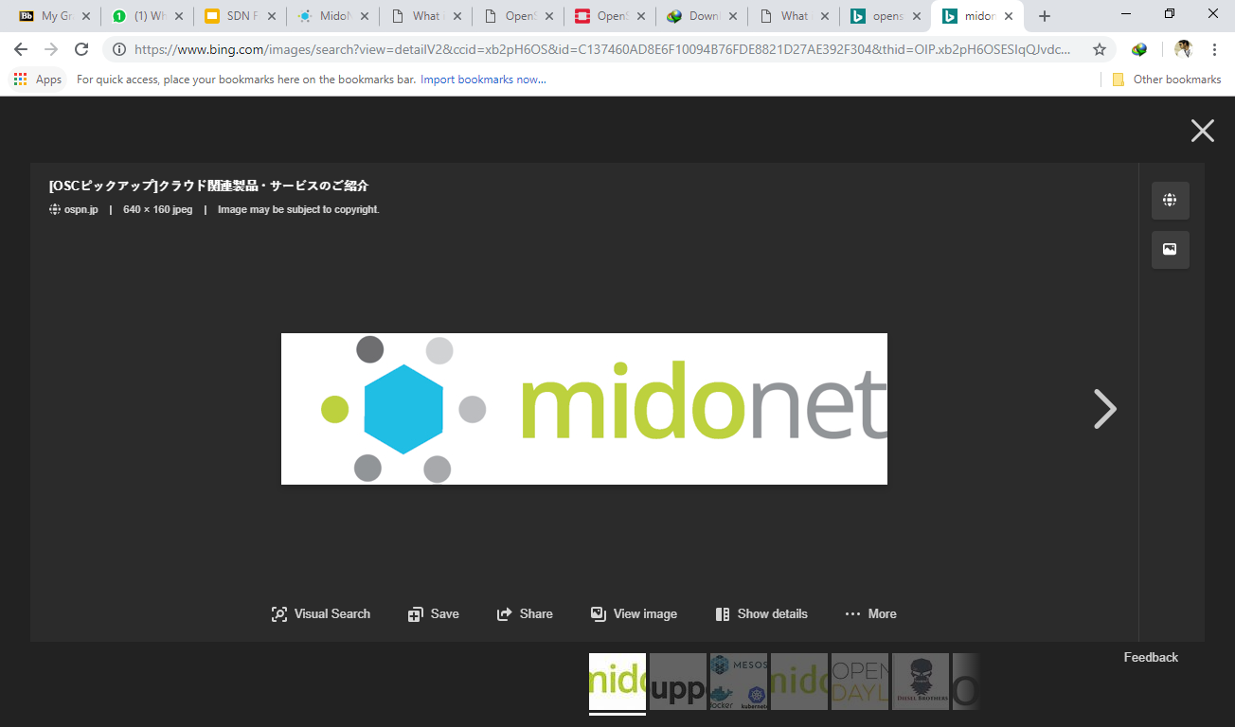
IMPLEMENTATION
Install Ubuntu 14.04/16.04
Install Openstack horizon Dashboard(Devstack).
Install Midonet CLI.
Open Horizon dashboard to create a topology containing routers, networks and interface attached to it, launch instances (VMs) in one tenant.
Switch to midonet cli and run midonet commands to control/manage the network.

Slide 9
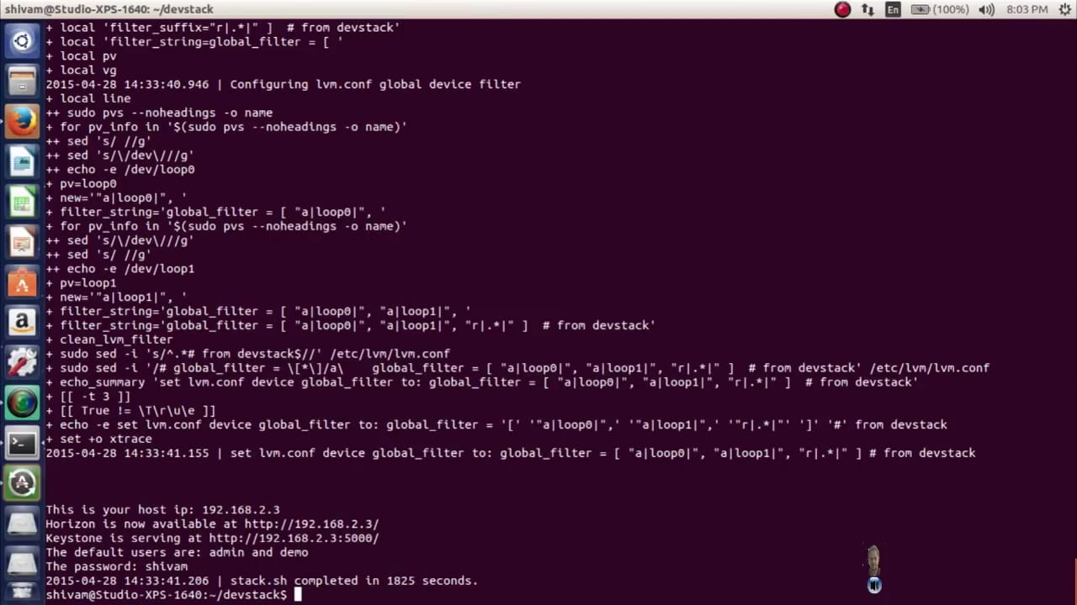
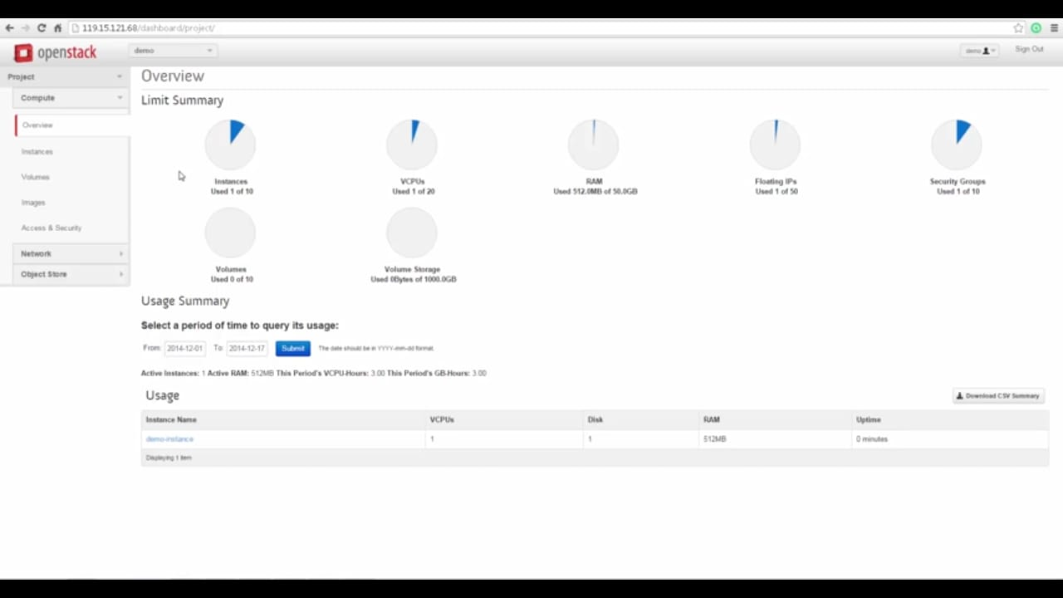
Successful Installation of Horizon Dashboard:
Horizon Dashboard:

Slide 10
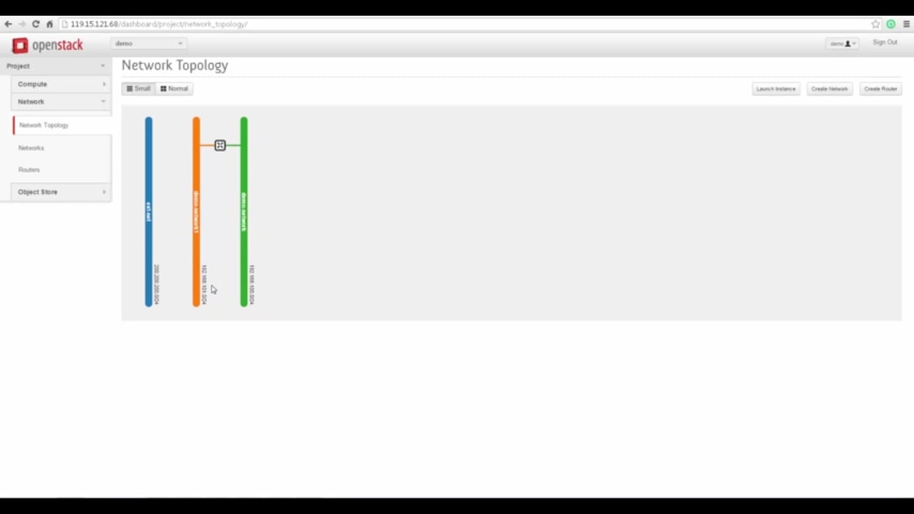
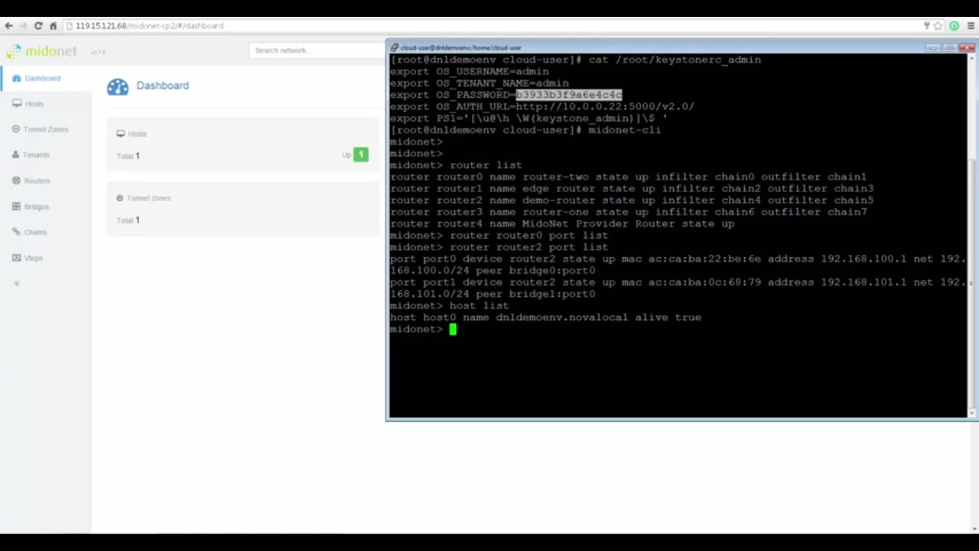
Network Topology:
Midonet CLI:

Slide 11
PROBLEMS FACED
Midonet and Horizon Dashboard works only with some specific versions of Ubuntu.
Many bugs/errors occurred during installation was resolved.
Lack of proper documentation on this technologies.

Slide 12
CONCLUSION
Started off with installing Openstack and Midonet software by resolving various issues encountered.
Integrated these two software's for utilizing the functionalities provided.
Network Topology is created in Horizon Dashboard and it is controlled through Midonet CLI.

Slide 13
REFERENCES
https://www.openstack.org/
https://www.midonet.org/
https://youtu.be/ImsloPClk-A
https://youtu.be/2JKiUF5V93M

Slide 14
THANK YOU…

